Slide 1
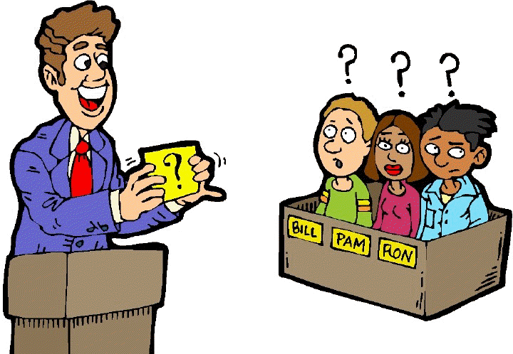
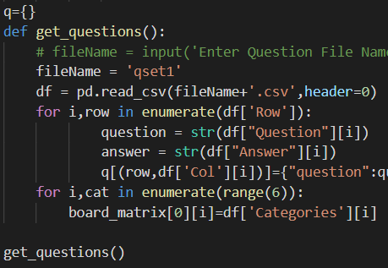
Can you guess the clue?
This Photo by Unknown author is licensed under CC BY-NC-ND.
A Sex Education jeopardy game to engage kids between ages 5-18
Coders: Chineze Okpala and Kara Wright
Original coder: pharzan, https://github.com/pharzan/py-jeopardy-game

Slide 2
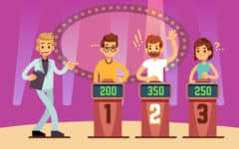
A Sex Education jeopardy game to engage kids between ages 5-18
HERE ARE TODAY'S CATEGORIES!
Developers: Chineze Okpala & Kara Wright
Original Developer:
Pharzan https://github.com/pharzan/py-jeopardy-game

Slide 3
